Slide 1
DERMATOLOGY TEAM 14
Dr. Ricardo Henao, Adrian Lopez, Brian Kim, Kinjal Sanghvi, Meng Xiao, Matt Engelhard

Slide 2
Agenda
Problem Statement
Dataset
Solution Approach
Active Learning
Results
Accomplishments & Going Forward

Slide 3
PROBLEM
STATEMENT
The dermatology department at the Duke Hospital has 25,509 images of skin lesions.
All these images are unlabelled and scale from “a very clear centered lesion” to an image of a full body with tiny lesions.
Our task is to train a model to create bounding boxes around each of these lesions and classify them.

Slide 4
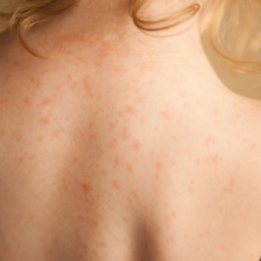
DATASETS
Our Dataset contains Duke Images as well as images from an online dataset (ISIC 2018).
To train our models, we use a combination of these images.
We have minimal number of ground truths to the 25,509 images provided by Duke Hospital. Therefore, we utilize Active Learning in training the model to maximize performance gain for each label.

Slide 5
SOLUTION APPROACH

Slide 6
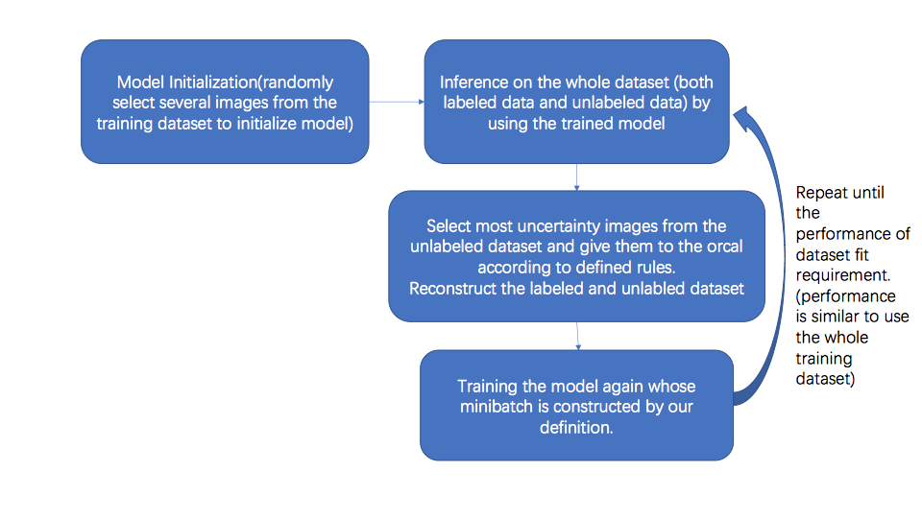
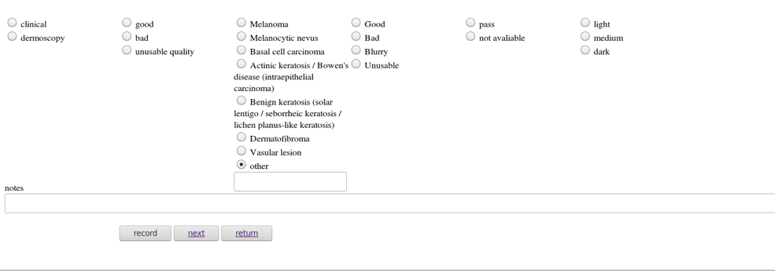
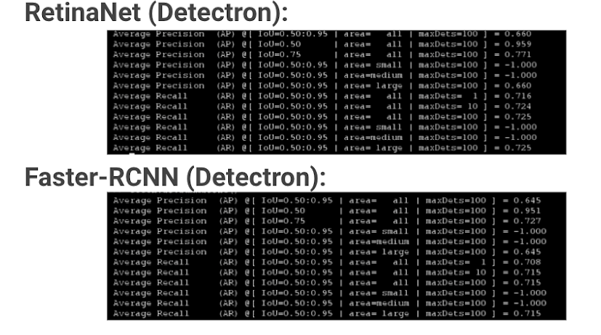
CREATE APPLICATION
TEST OBJECT DETECTION MODELS
ACTIVE LEARNING SOLUTION

Slide 7
Active Learning
Select Labelled Images
Train Model and Inference
Select images from category D1, D2, D3
Train model on mini batches of these images
Inference Model again
D1 = 1 Random Labelled Image
D2 = 1 Labelled Image with Score ~ 1/(N+1)
D3 = 2 Unlabelled Images with Score ~ 1/(N+1)
N = Number of Classes, 1 = Background Class

Slide 8
RESULTS

Slide 9
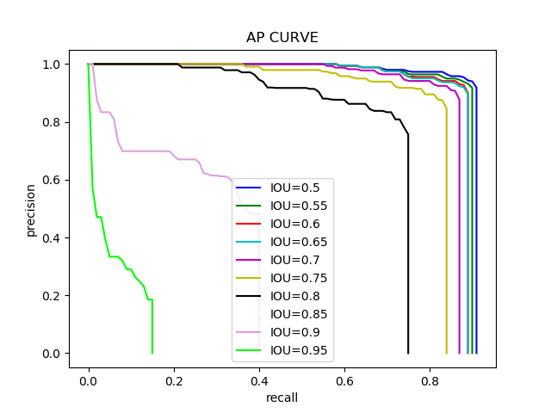
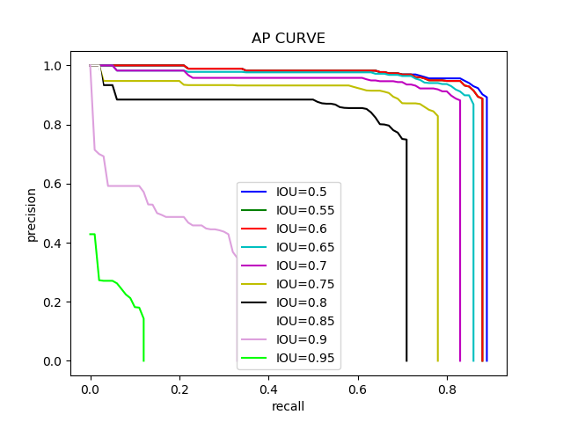
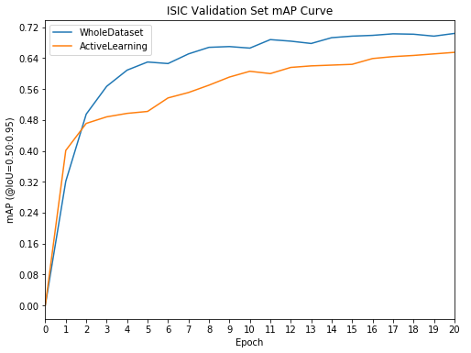
ISIC Dataset Results (RetinaNet):
Whole Dataset Training:
Active Learning:
Training Process:
Train on the whole dataset (2334 images) at every epoch
Training Process:
Train on random subset of 40 labelled images for 5 epochs
At each following epoch, train on 20 mini-batches of 4 images selected based on D1, D2, D3 criteria
Total # images used per epoch: 80
Notes:
For the map curve, start at same baseline and make y axis, gain of mAP over epochs

Slide 10
ACCOMPLISHMENTS
& GOING FORWARD

Slide 11
Accomplishments:
Going Forward:
Successfully set up an AL pipeline using RetinaNet
Tested and validated its effectiveness and efficiency using the ISIC dataset
Recognized some key problems with performance on Duke dataset: varying image quality, glare, size of lesions, etc.
Incorporate the Duke clinical data into the pipeline
Further automate the process by integrating the lesion app within the AL pipeline to serve as an oracle
Continue to improve the performance on the highly varying Duke dataset

Slide 12
Thank You

